Slide 1


Azərbaycan Dövlət Neft və Sənaye Universiteti
Calculus
Single Variable

Slide 2
Limits at Infinity

Slide 3
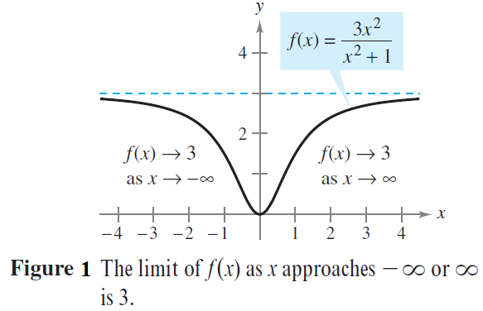
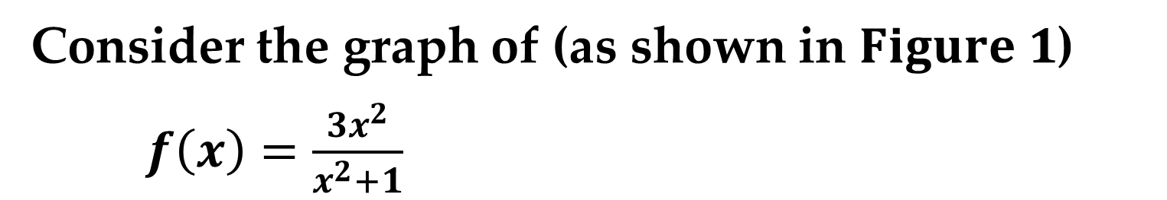
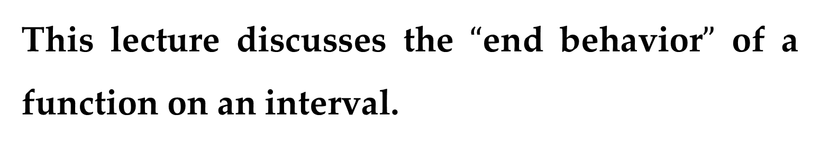
This lecture discusses the $“$end behavior$”$ of a function on an interval.
Consider the graph of (as shown in $Figure 1$)
$f\left(x\right)=\frac{3x^{2}}{x^{2}+1}$

Slide 4
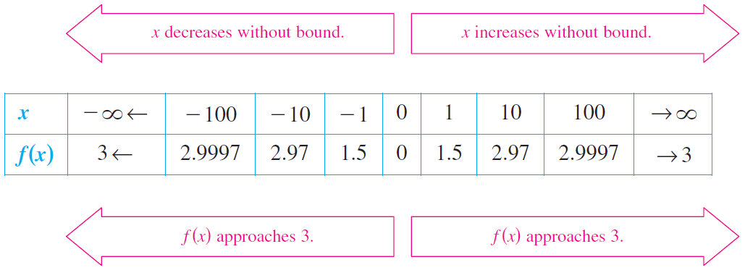
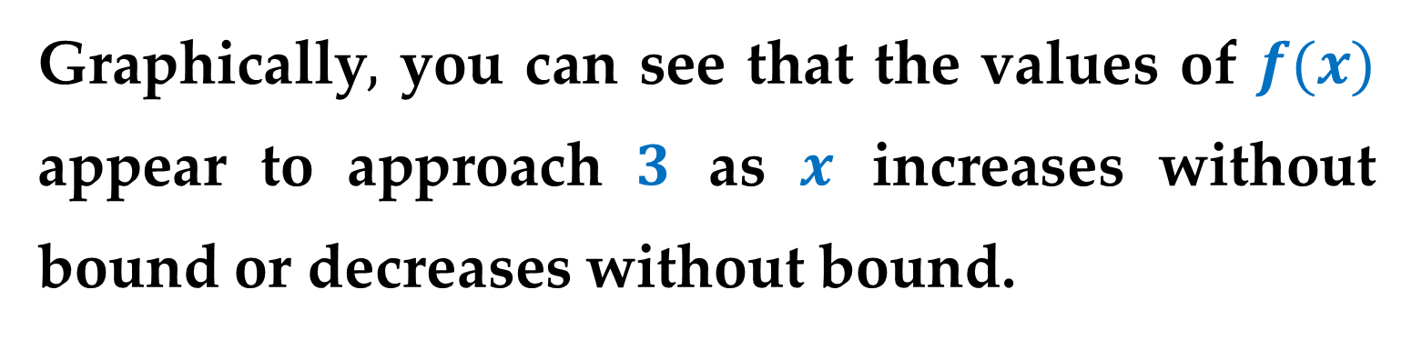
Graphically$,$ you can see that the values of $f(x)$ appear to approach $3$ as $x$ increases without bound or decreases without bound.
You can come to the same conclusion numerically, as shown in the table.

Slide 5
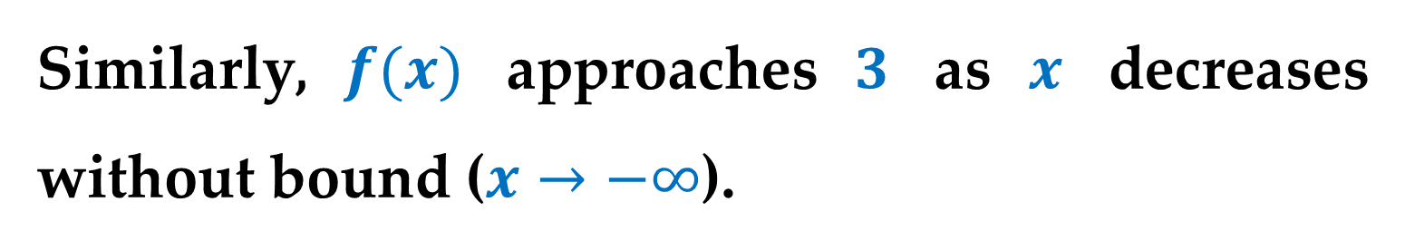
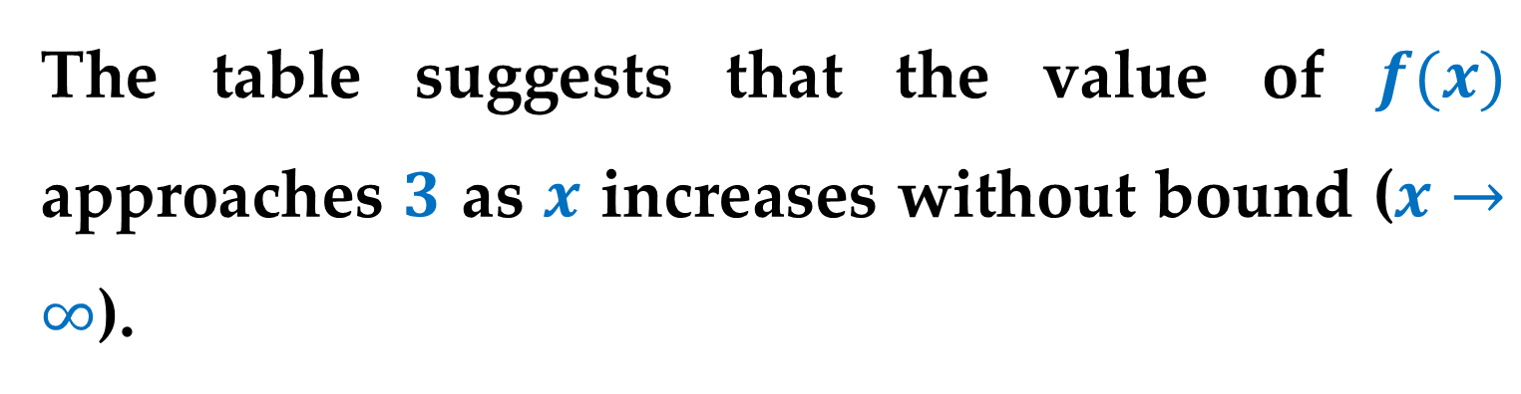
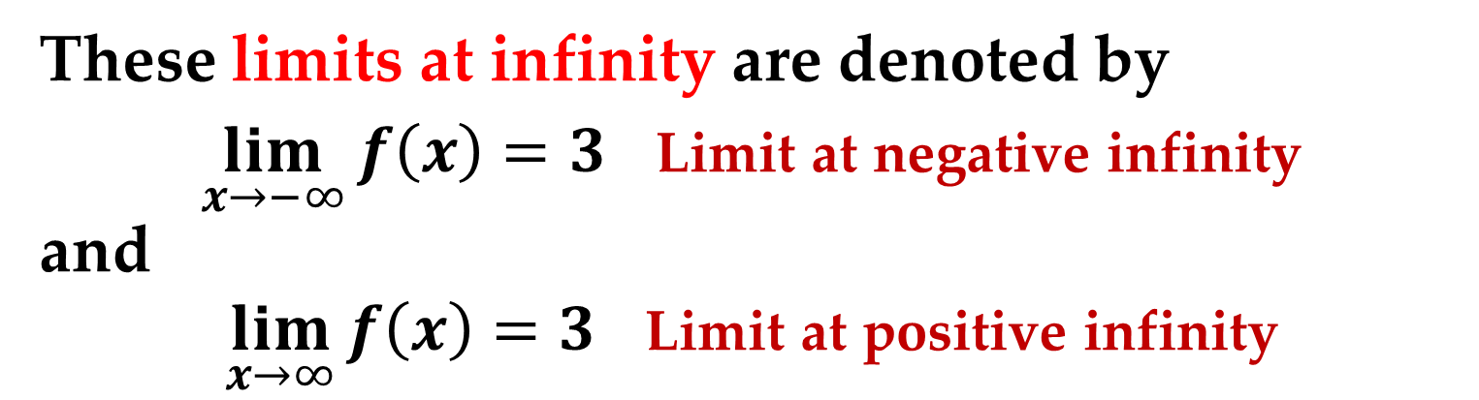
The table suggests that the value of $f(x)$ approaches $3$ as $x$ increases without bound ($x→∞$).
Similarly, $f(x)$ approaches $3$ as $x$ decreases without bound ($x→−∞$).
These limits at infinity are denoted by
$\lim_{x→−∞}{f\left(x\right)}=3$ Limit at negative infinity
and
$\lim_{x→∞}{f\left(x\right)}=3$ Limit at positive infinity

Slide 6
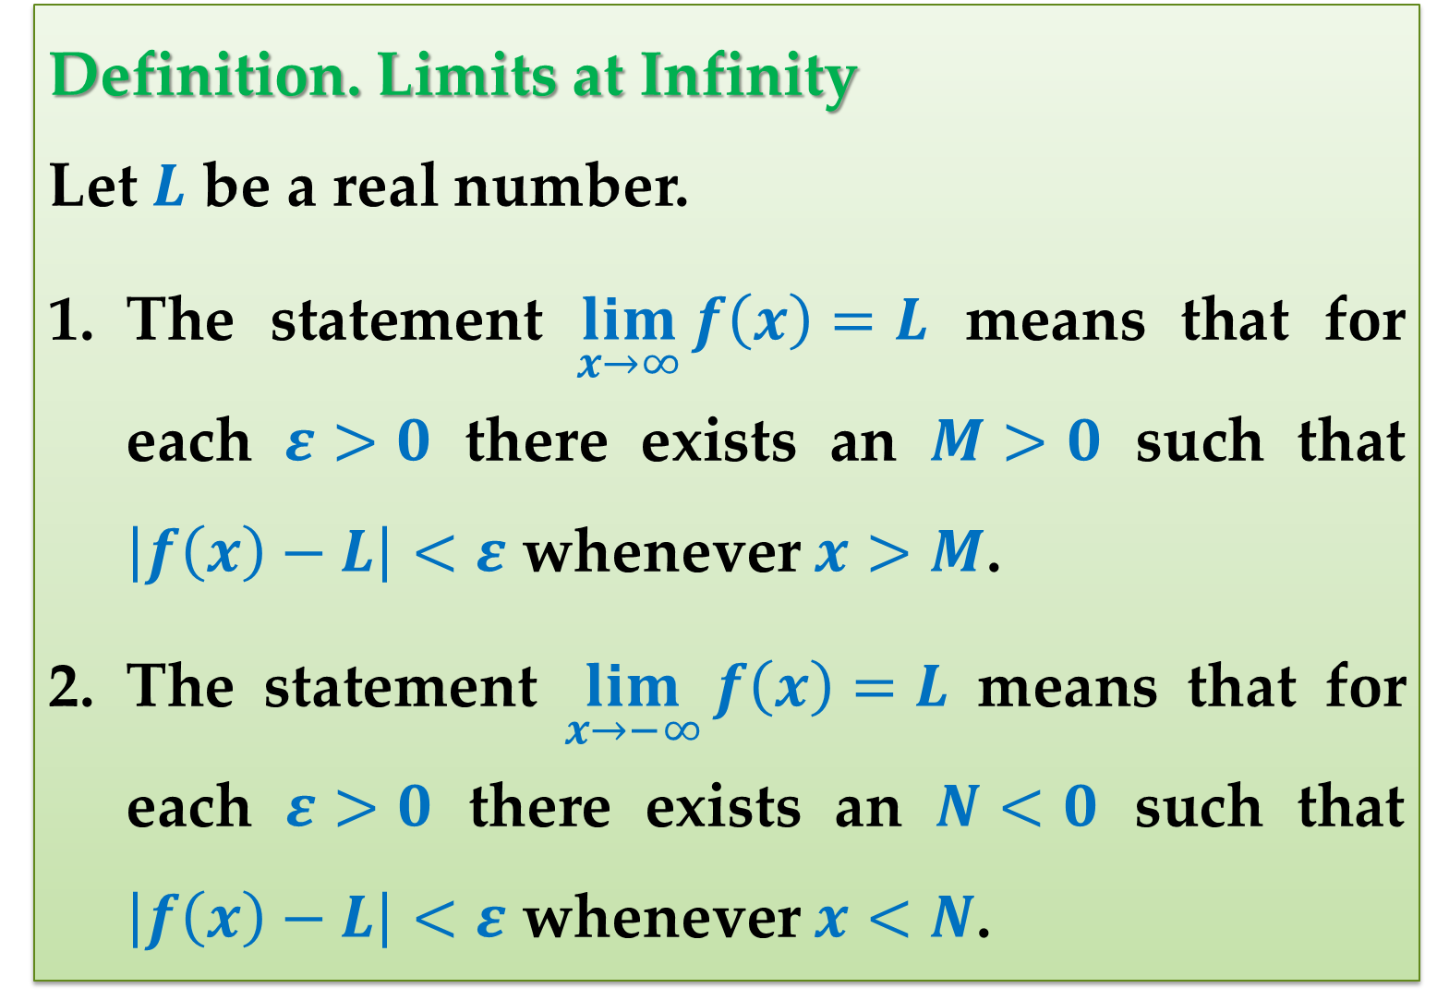
Definition. Limits at Infinity
Let $L$ be a real number.
The statement $\lim_{x→∞}{f\left(x\right)}=L$ means that for each $ε>0$ there exists an $M>0$ such that $\left|f\left(x\right)−L\right|<ε$ whenever $x>M$.
The statement $\lim_{x→−∞}{f\left(x\right)}=L$ means that for each $ε>0$ there exists an $N<0$ such that $\left|f\left(x\right)−L\right|<ε$ whenever $x<N$.

Slide 7
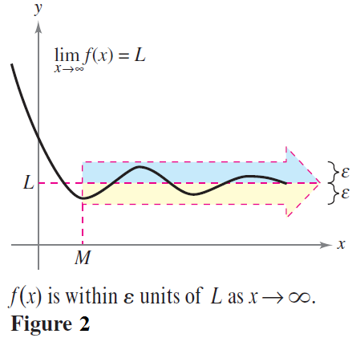
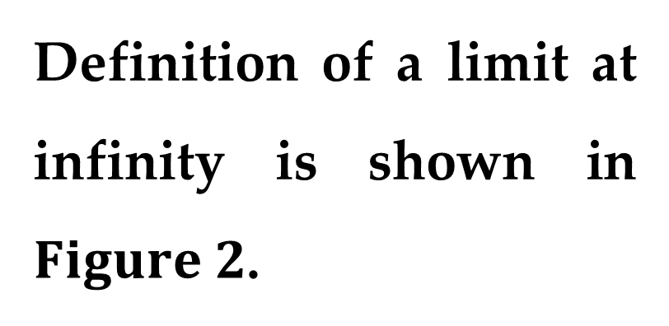
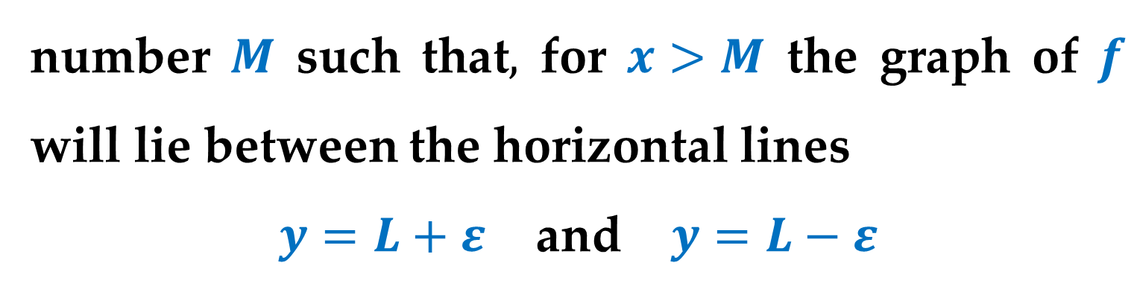
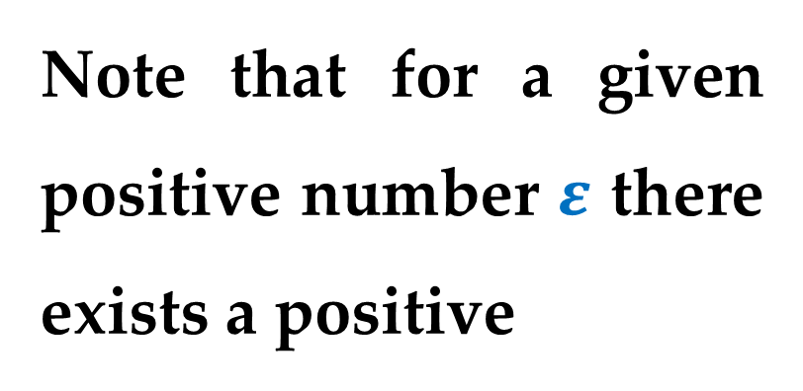
Definition of a limit at infinity is shown in $Figure 2$.
Note that for a given positive number $ε$ there exists a positive
number $M$ such that$,$ for $x>M$ the graph of $f$ will lie between the horizontal lines
$y=L+ε$ and $y=L−ε$

Slide 8
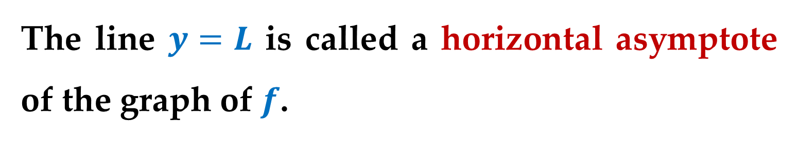
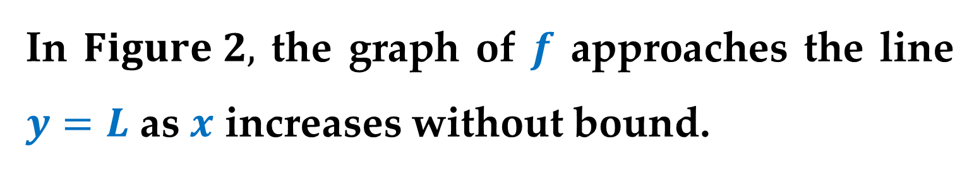
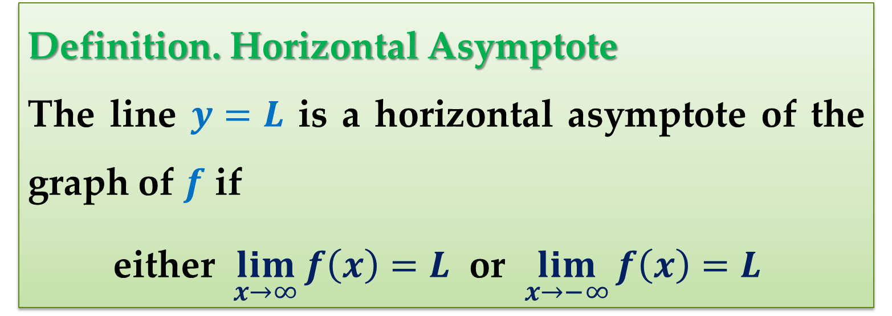
In $Figure 2,$ the graph of $f$ approaches the line $y=L$ as $x$ increases without bound.
The line $y=L$ is called a horizontal asymptote of the graph of $f$.
Definition. Horizontal Asymptote
The line $y=L$ is a horizontal asymptote of the graph of $f$ if
either $\lim_{x→∞}{f\left(x\right)}=L$ or $\lim_{x→−∞}{f\left(x\right)}=L$

Slide 9
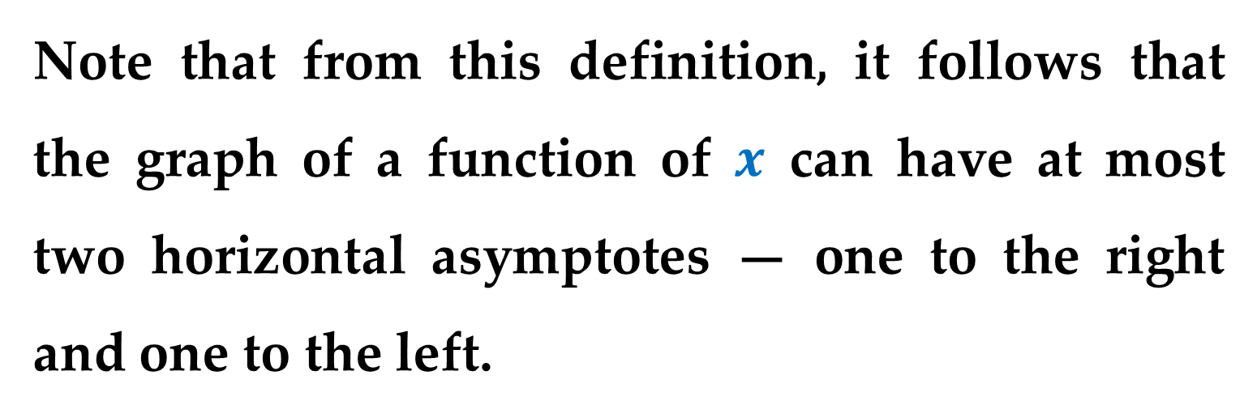
Remark
Note that from this definition, it follows that the graph of a function of $x$ can have at most two horizontal asymptotes — one to the right and one to the left.
Limits at infinity have many of the same properties of limits discussed previously.

Slide 10
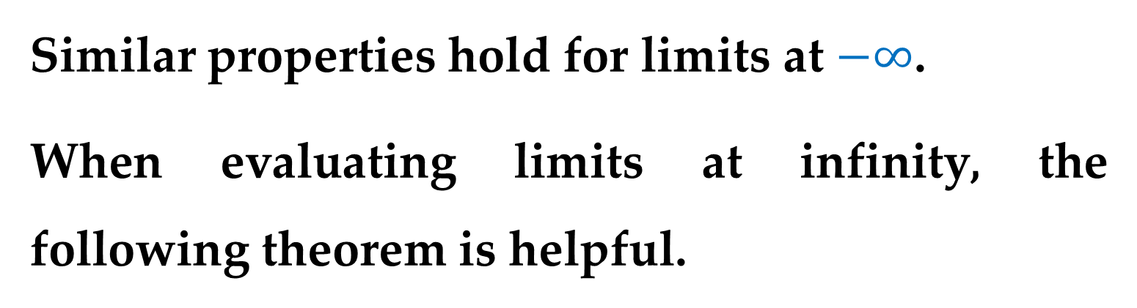
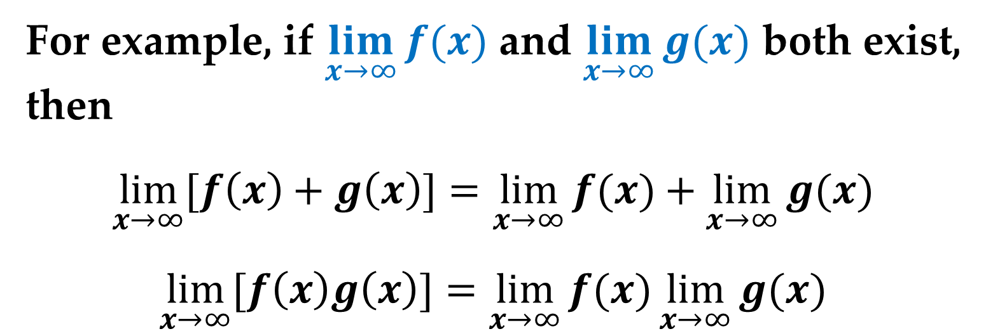
For example, if $\lim_{x→∞}{f(x)}$ and $\lim_{x→∞}{g(x)}$ both exist, then
$$\lim_{x→∞}{[f\left(x\right)+g\left(x\right)]}=\lim_{x→∞}{f(x)}+\lim_{x→∞}{g(x)}$$
$$\lim_{x→∞}{[f\left(x\right)g\left(x\right)]}=\lim_{x→∞}{f(x)}\lim_{x→∞}{g(x)}$$
Similar properties hold for limits at $−∞$.
When evaluating limits at infinity, the following theorem is helpful.

Slide 11
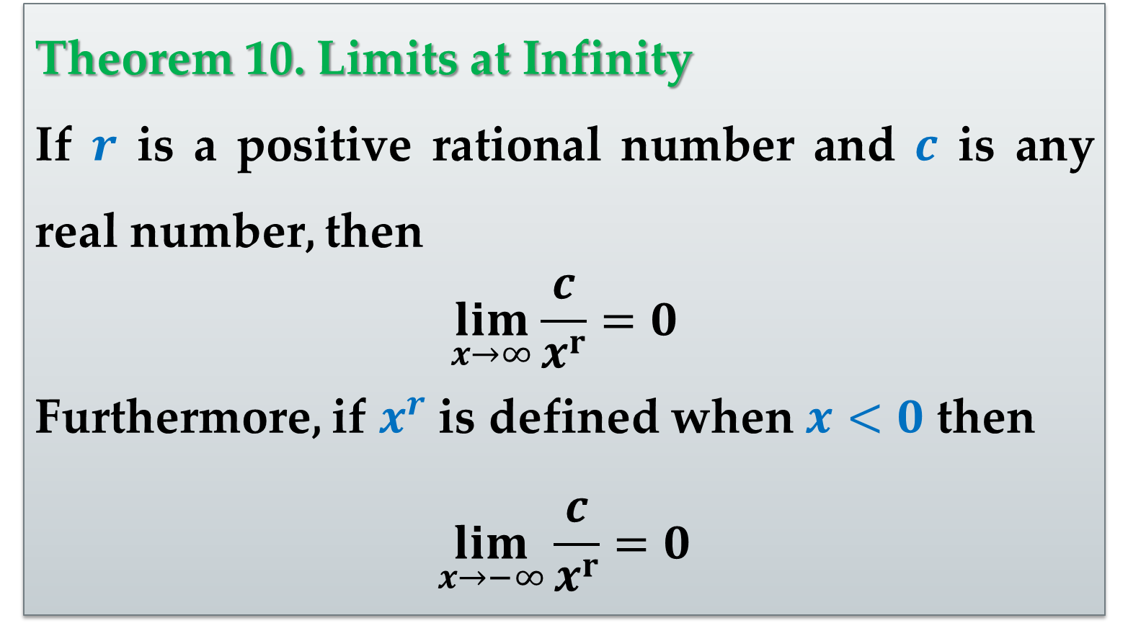
Theorem 10. Limits at Infinity
If $r$ is a positive rational number and $c$ is any real number, then
$$\lim_{x→∞}{\frac{c}{x^{r}}}=0$$
Furthermore, if $x^{r}$ is defined when $x<0$ then
$$\lim_{x→−∞}{\frac{c}{x^{r}}}=0$$

Slide 12
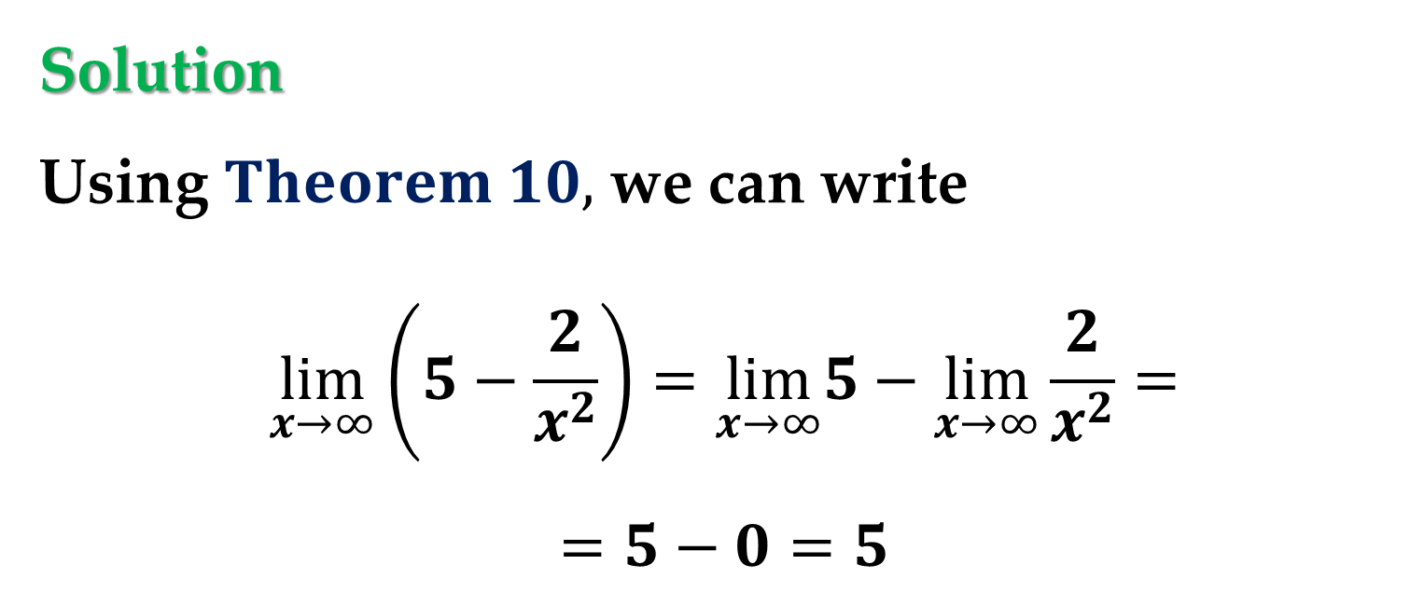

Example 1. Finding a Limit at Infinity
Find the limit
$$\lim_{x→∞}\left(5−\frac{2}{x^{2}}\right)$$
Solution
Using $Theorem 10,$ we can write
$$\lim_{x→∞}\left(5−\frac{2}{x^{2}}\right)=\lim_{x→∞}5−\lim_{x→∞}\frac{2}{x^{2}}=$$
$$=5−0=5$$

Slide 13
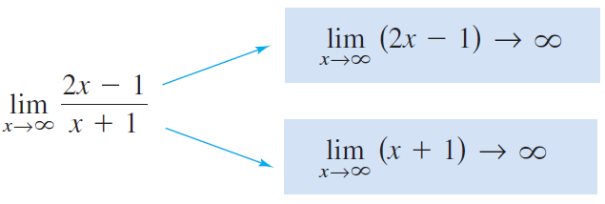
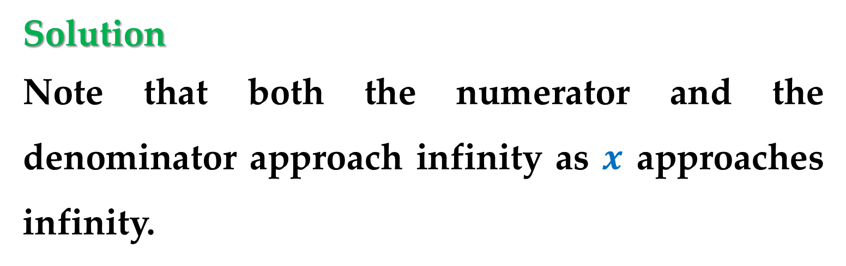

Example 2. Finding a Limit at Infinity
Find the limit
$$\lim_{x→∞}{\frac{2x−1}{x+1}}$$
Solution
Note that both the numerator and the denominator approach infinity as $x$ approaches infinity.

Slide 14
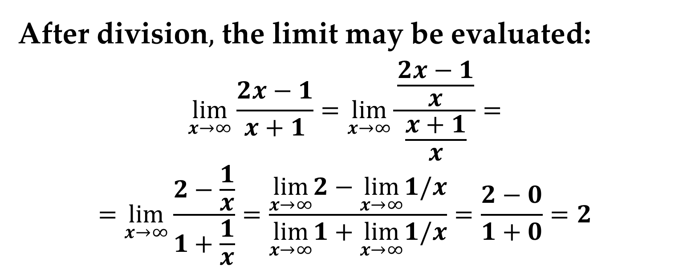
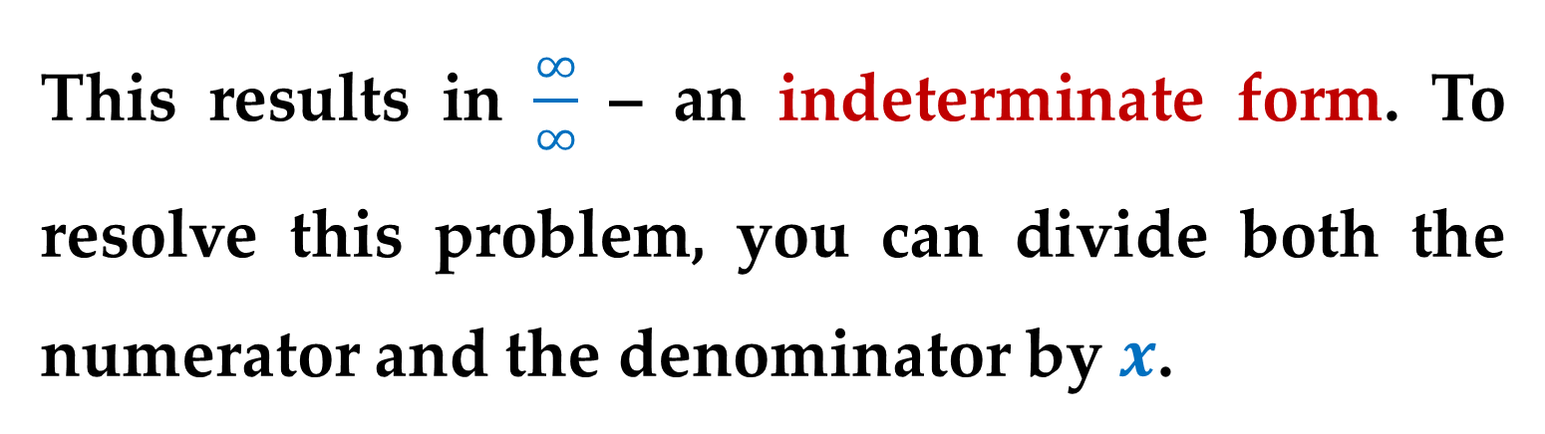
Solution (continued)
This results in $\frac{∞}{∞}$ – an indeterminate form. To resolve this problem, you can divide both the numerator and the denominator by $x$.
After division$,$ the limit may be evaluated:
$$\lim_{x→∞}{\frac{2x−1}{x+1}}=\lim_{x→∞}{\frac{\frac{2x−1}{x}}{\frac{x+1}{x}}}=$$
$$=\lim_{x→∞}\frac{2−\frac{1}{x}}{1+\frac{1}{x}}=\frac{\lim_{x→∞}2−\lim_{x→∞}1/x}{\lim_{x→∞}1+\lim_{x→∞}1/x}=\frac{2−0}{1+0}=2$$

Slide 15
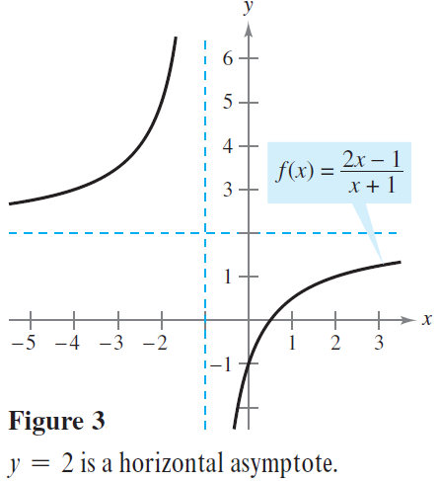
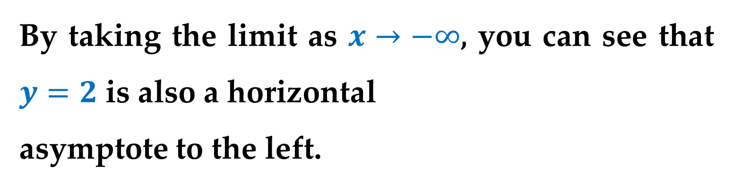
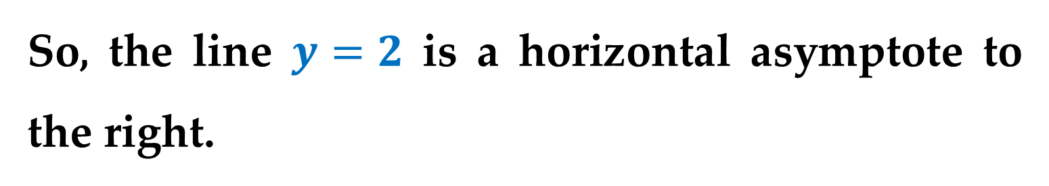
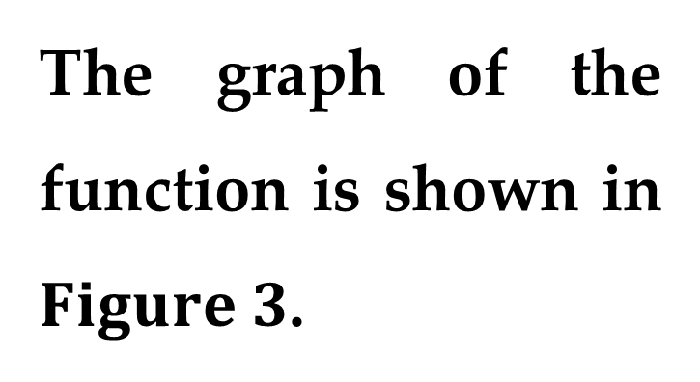
Solution (continued)
So, the line $y=2$ is a horizontal asymptote to the right.
By taking the limit as $x→−∞$, you can see that $y=2$ is also a horizontal
asymptote to the left.
The graph of the function is shown in $Figure 3$.

Slide 16
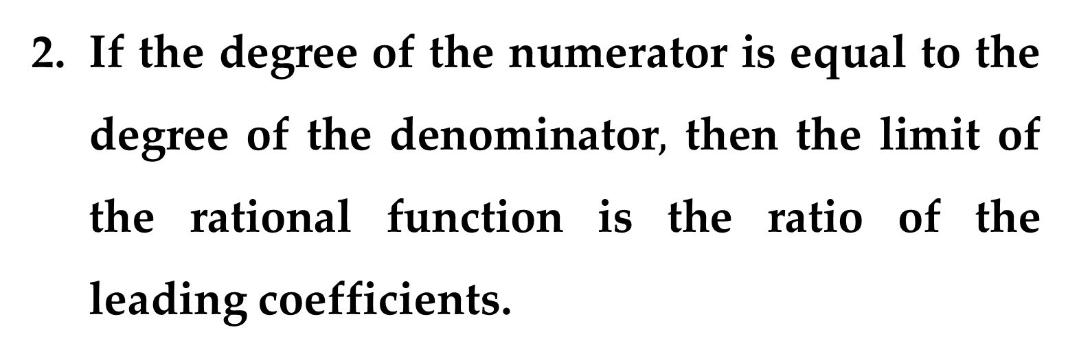
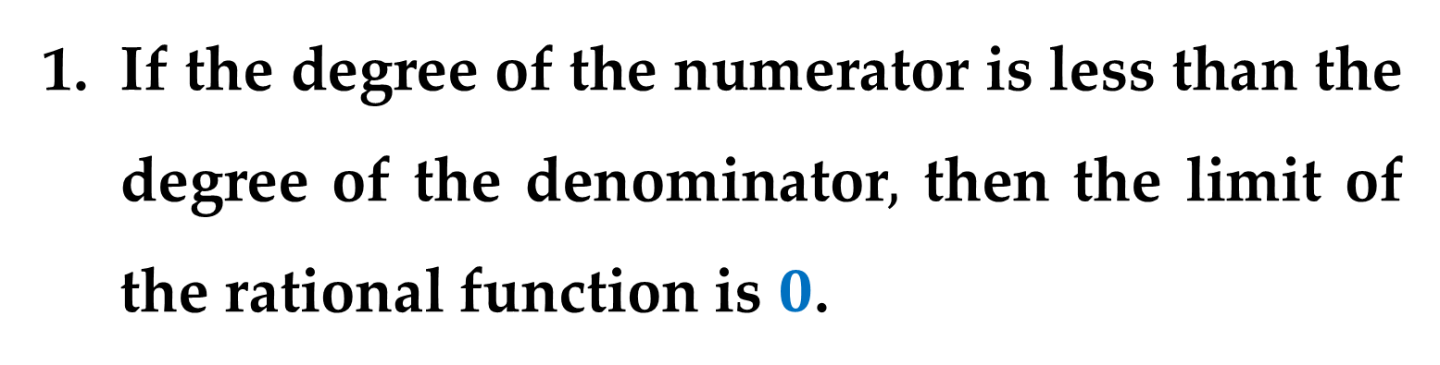

Guidelines for Finding Limits at $±∞$ of Rational Functions
If the degree of the numerator is less than the degree of the denominator$,$ then the limit of the rational function is $0$.
If the degree of the numerator is equal to the degree of the denominator$,$ then the limit of the rational function is the ratio of the leading coefficients.

Slide 17
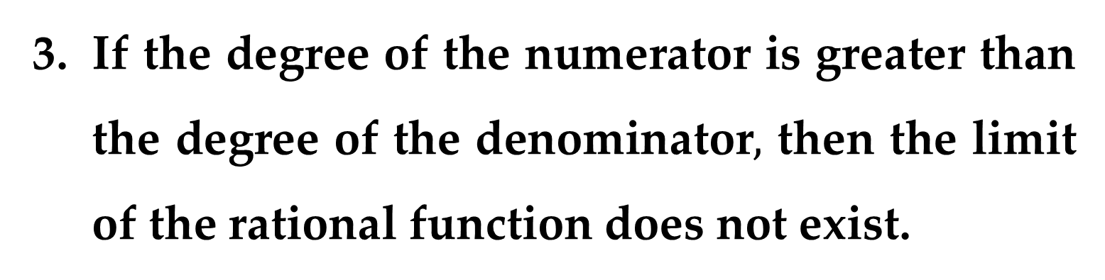
Guidelines for Finding Limits at $±∞$ of Rational Functions
If the degree of the numerator is greater than the degree of the denominator$,$ then the limit of the rational function does not exist.

Slide 18
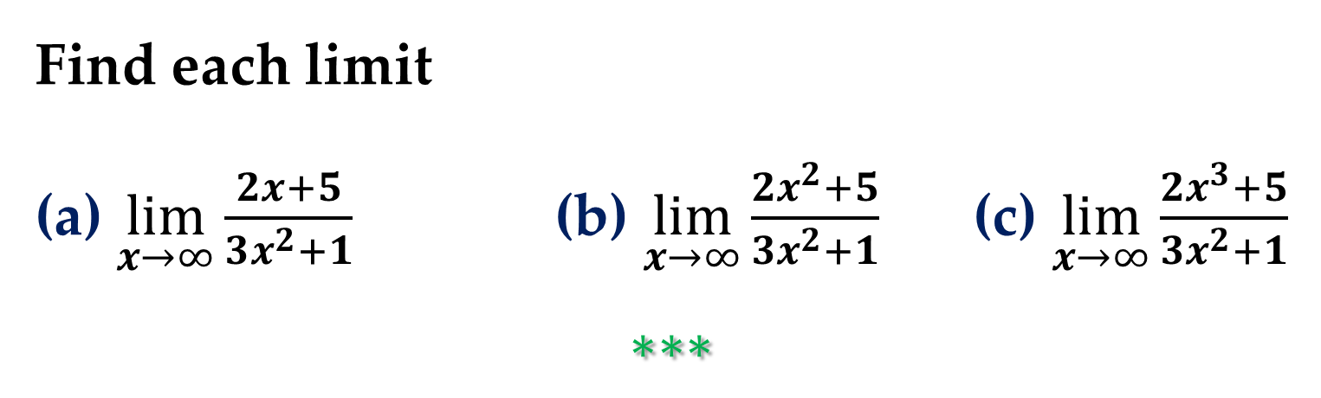
Example 3. A Comparison of Three Rational Functions
Find each limit
(a) $\lim_{x→∞}{\frac{2x+5}{3x^{2}+1}}$ (b) $\lim_{x→∞}{\frac{2x^{2}+5}{3x^{2}+1}}$ (c) $\lim_{x→∞}{\frac{2x^{3}+5}{3x^{2}+1}}$
$$∗∗∗$$

Slide 19
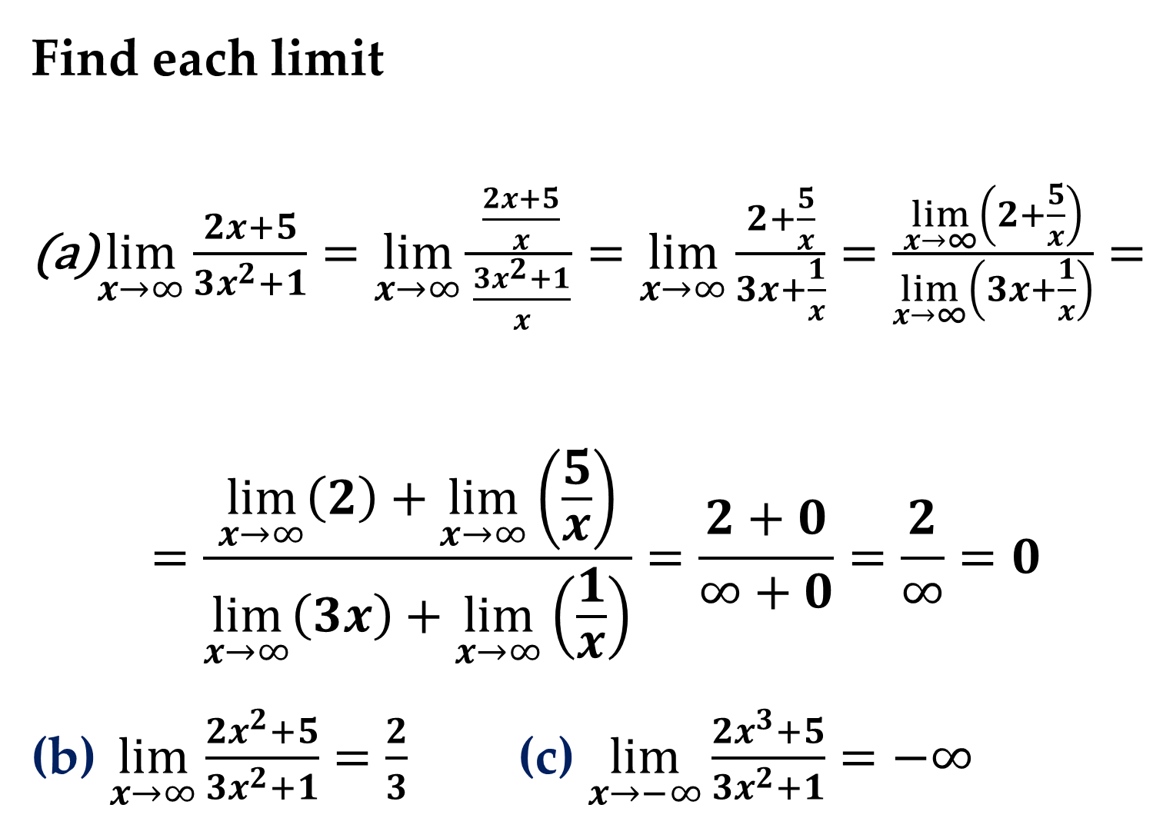
Find each limit
$\lim_{x→∞}{\frac{2x+5}{3x^{2}+1}}=\lim_{x→∞}{\frac{\frac{2x+5}{x}}{\frac{3x^{2}+1}{x}}}=\lim_{x→∞}{\frac{2+\frac{5}{x}}{3x+\frac{1}{x}}}=\frac{\lim_{x→∞}\left(2+\frac{5}{x}\right)}{\lim_{x→∞}\left(3x+\frac{1}{x}\right)}=$
$$=\frac{\lim_{x→∞}\left(2\right)+\lim_{x→∞}\left(\frac{5}{x}\right)}{\lim_{x→∞}\left(3x\right)+\lim_{x→∞}\left(\frac{1}{x}\right)}=\frac{2+0}{∞+0}=\frac{2}{∞}=0$$
(b) $\lim_{x→∞}{\frac{2x^{2}+5}{3x^{2}+1}}=\frac{2}{3}$ (c) $\lim_{x→−∞}{\frac{2x^{3}+5}{3x^{2}+1}}=−∞$

Slide 20
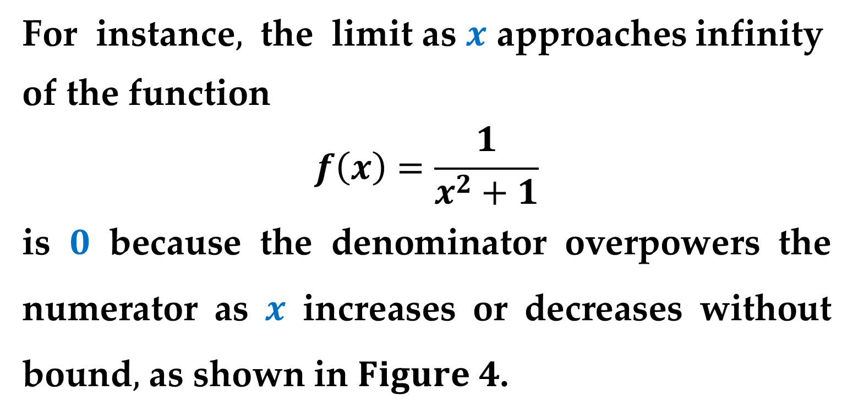
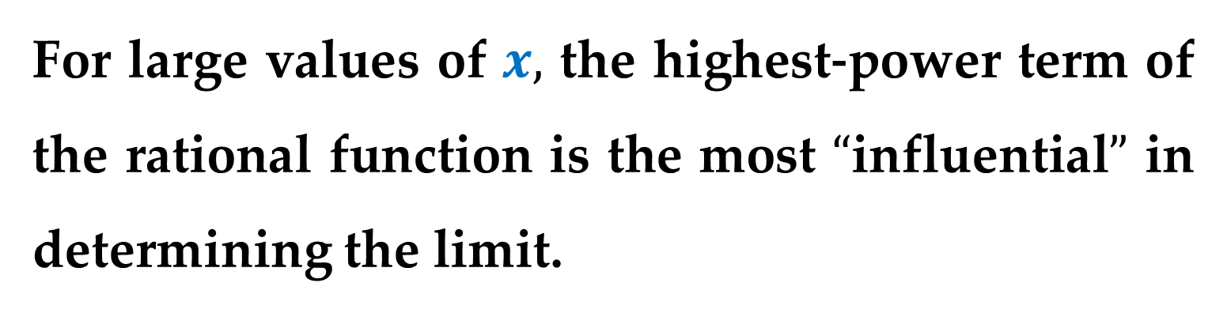
For large values of $x,$ the highest-power term of the rational function is the most $“$influential$”$ in determining the limit.
For instance$,$ the limit as $x$ approaches infinity
of the function
$$f\left(x\right)=\frac{1}{x^{2}+1}$$
is $0$ because the denominator overpowers the numerator as $x$ increases or decreases without bound$,$ as shown in $Figure 4$.

Slide 21
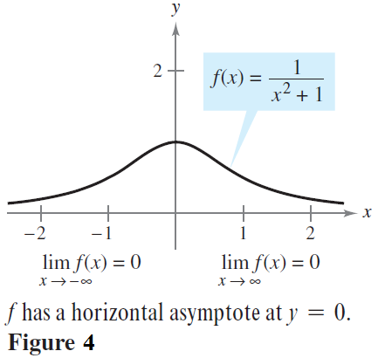
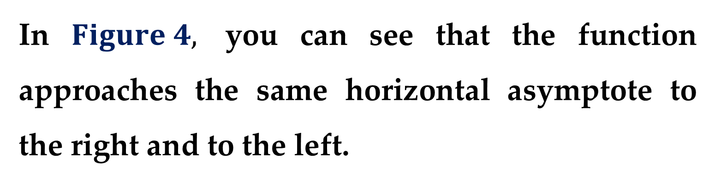
In $Figure 4,$ you can see that the function approaches the same horizontal asymptote to the right and to the left.
This is always true of rational functions.

Slide 22
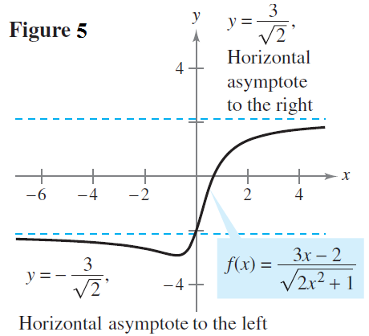
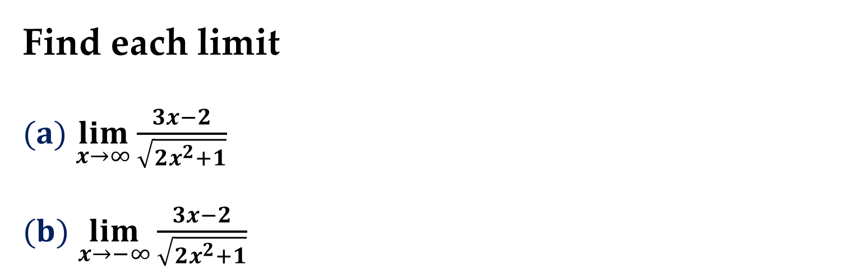
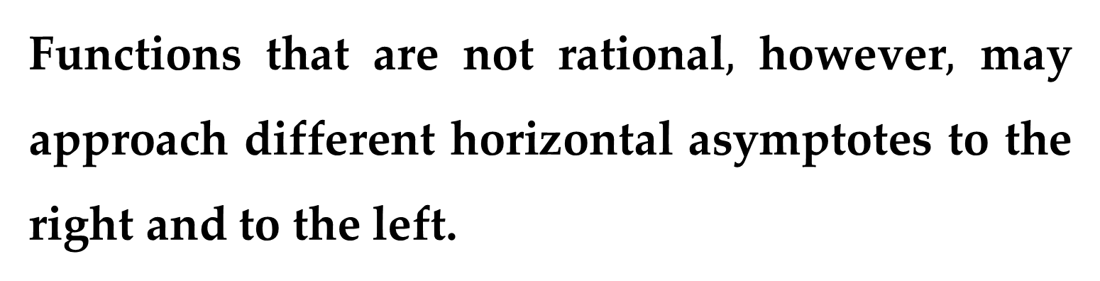
Functions that are not rational$,$ however$,$ may approach different horizontal asymptotes to the right and to the left.
Example 4. A Function with Two Horizontal Asymptotes
Find each limit
$(a)$ $\lim_{x→∞}{\frac{3x−2}{\sqrt{2x^{2}+1}}}$
$(b)$ $\lim_{x→−∞}{\frac{3x−2}{\sqrt{2x^{2}+1}}}$

Slide 23
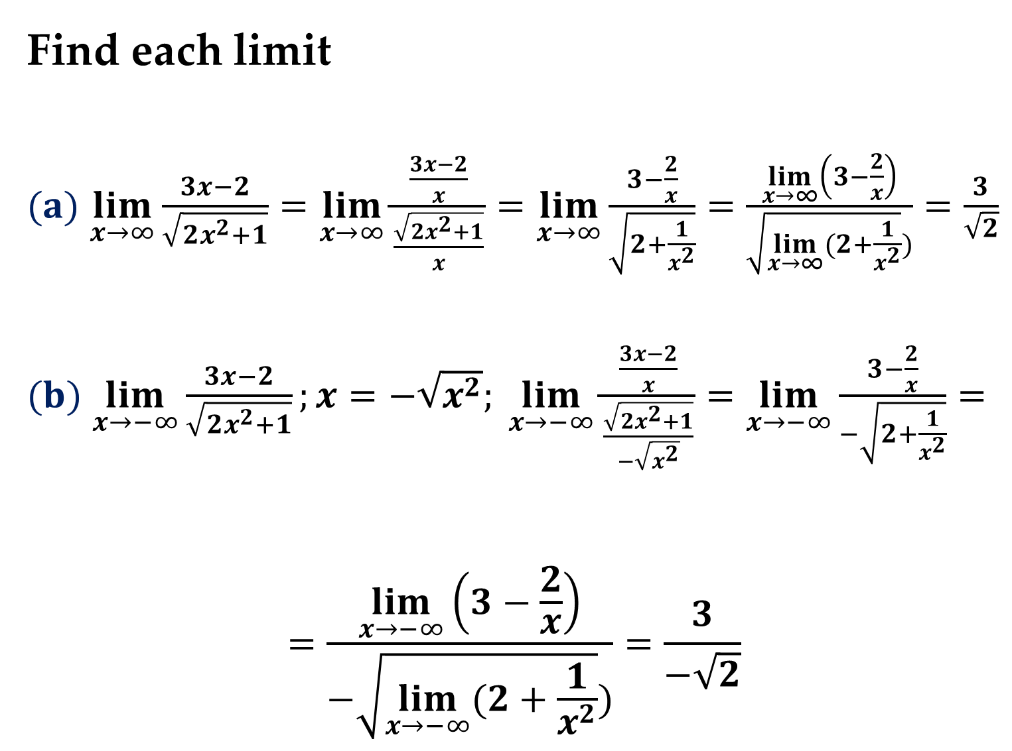
Find each limit
$(a)$ $\lim_{x→∞}{\frac{3x−2}{\sqrt{2x^{2}+1}}}=\lim_{x→∞}{\frac{\frac{3x−2}{x}}{\frac{\sqrt{2x^{2}+1}}{x}}}=\lim_{x→∞}{\frac{3−\frac{2}{x}}{\sqrt{2+\frac{1}{x^{2}}}}}=\frac{\lim_{x→∞}\left(3−\frac{2}{x}\right)}{\sqrt{\lim_{x→∞}(2+\frac{1}{x^{2}}})}=\frac{3}{\sqrt{2}}$
$(b)$ $\lim_{x→−∞}{\frac{3x−2}{\sqrt{2x^{2}+1}}};x=−\sqrt{x^{2}}; \lim_{x→−∞}{\frac{\frac{3x−2}{x}}{\frac{\sqrt{2x^{2}+1}}{−\sqrt{x^{2}}}}}=\lim_{x→−∞}{\frac{3−\frac{2}{x}}{−\sqrt{2+\frac{1}{x^{2}}}}}=$
$$=\frac{\lim_{x→−∞}\left(3−\frac{2}{x}\right)}{−\sqrt{\lim_{x→−∞}(2+\frac{1}{x^{2}}})}=\frac{3}{−\sqrt{2}}$$

Slide 24
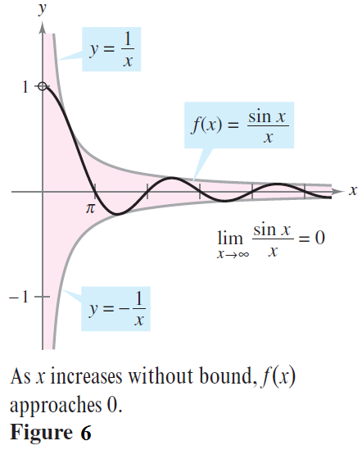

Example 5. Limits Involving Trigonometric Functions
Find each limit
$(a)$ $\lim_{x→∞}{\sin{x}}−does not exist$
$(b)$ $\lim_{x→∞}{\frac{\sin{x}}{x}}=0$
$−\frac{1}{x}≤\frac{\sin{x}}{x}≤\frac{1}{x}$
$h\left(x\right)≤f\left(x\right)≤g\left(x\right)$

Slide 25
Infinite Limits at Infinity

Slide 26
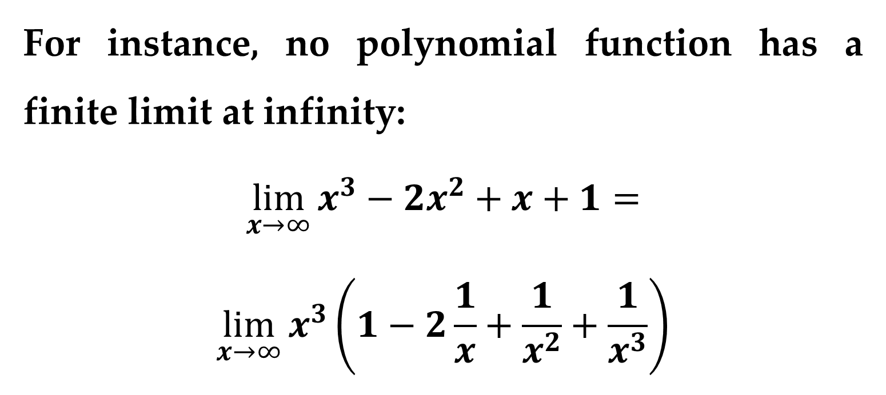
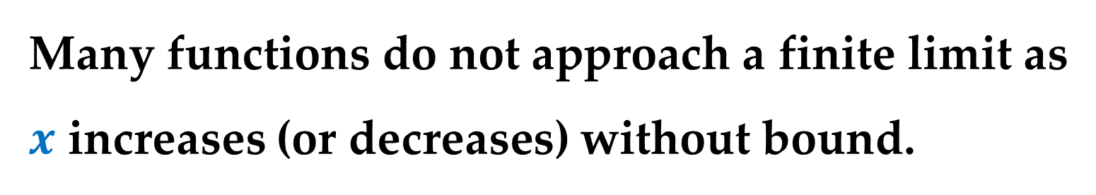
Many functions do not approach a finite limit as $x$ increases (or decreases) without bound.
For instance, no polynomial function has a finite limit at infinity:
$$\lim_{x→∞}{x^{3}−2x^{2}+x+1=}$$
$$\lim_{x→∞}{x^{3}\left(1−2\frac{1}{x}+\frac{1}{x^{2}}+\frac{1}{x^{3}}\right)}$$

Slide 27
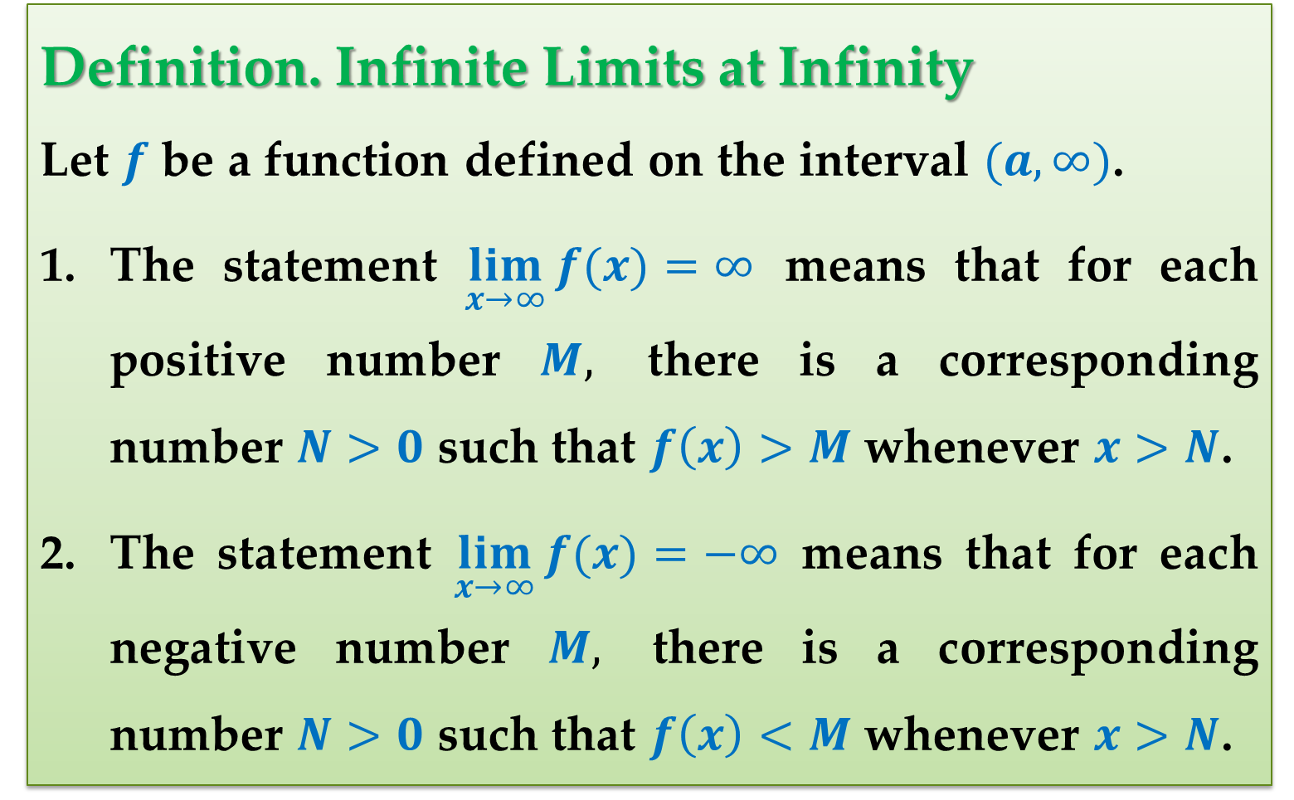
Definition. Infinite Limits at Infinity
Let $f$ be a function defined on the interval $(a,∞)$.
The statement $\lim_{x→∞}{f(x)}=∞$ means that for each positive number $M,$ there is a corresponding number $N>0$ such that $f\left(x\right)>M$ whenever $x>N$.
The statement $\lim_{x→∞}{f(x)}=−∞$ means that for each negative number $M,$ there is a corresponding number $N>0$ such that $f\left(x\right)<M$ whenever $x>N$.

Slide 28
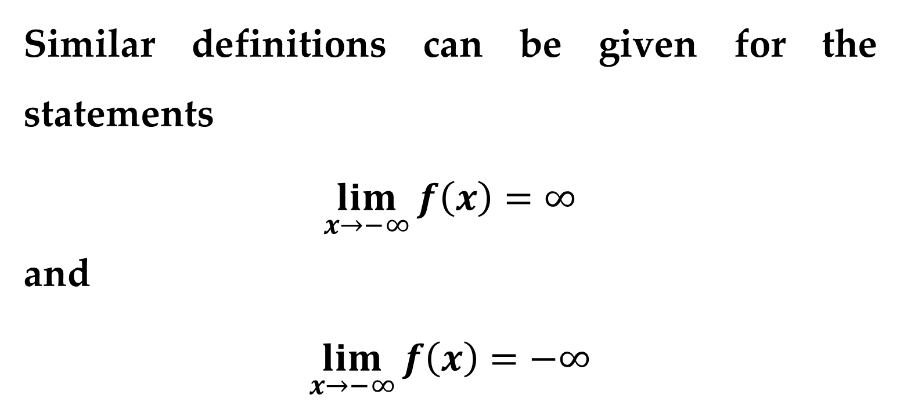
Remark
Similar definitions can be given for the statements
$$\lim_{x→−∞}{f\left(x\right)}=∞$$
and
$$\lim_{x→−∞}{f\left(x\right)}=−∞$$

Slide 29
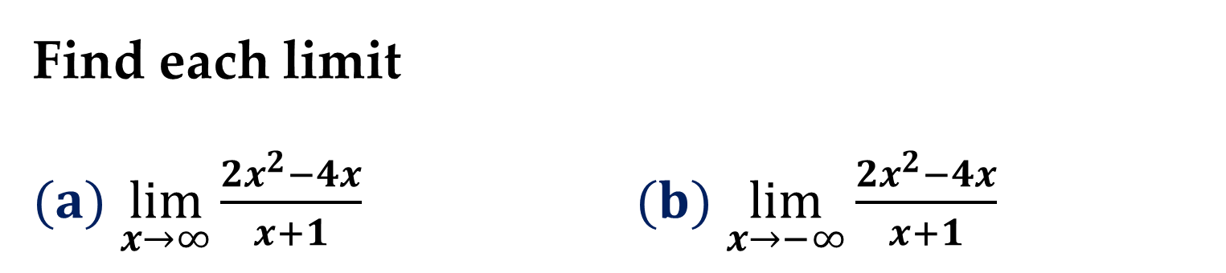
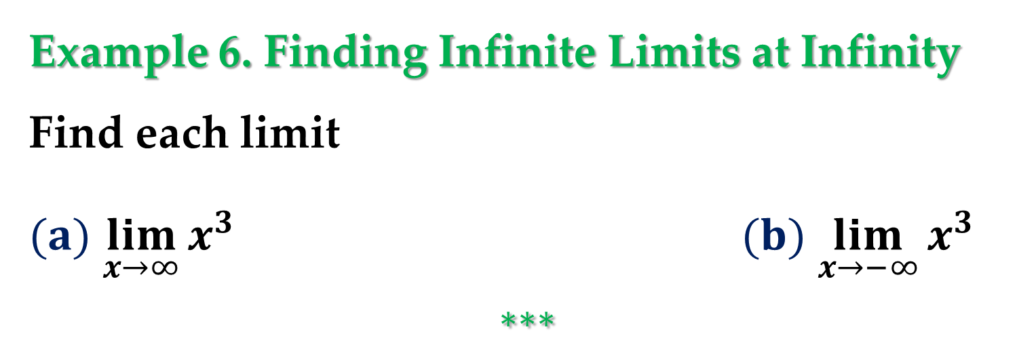
Example 6. Finding Infinite Limits at Infinity
Find each limit
$(a)$ $\lim_{x→∞}{x^{3}}$ $(b)$ $\lim_{x→−∞}{x^{3}}$
$$∗∗∗$$
Example 7. Finding Infinite Limits at Infinity
Find each limit
$(a)$ $\lim_{x→∞}{\frac{2x^{2}−4x}{x+1}}$ $(b)$ $\lim_{x→−∞}{\frac{2x^{2}−4x}{x+1}}$

Slide 30

Solution
One way to evaluate each of these limits is to use long division to rewrite the improper rational function as the sum of a polynomial and a rational function.
$(a)$ $\lim_{x→∞}{\frac{2x^{2}−4x}{x+1}}=\lim_{x→∞}\left(2x−6+\frac{6}{x+1}\right)=$
$$=\lim_{x→∞}\left(2x−6\right)+\lim_{x→∞}\frac{6}{x+1}=∞+0=∞$$

Slide 31

Solution (continued)
$(b)$ $\lim_{x→−∞}{\frac{2x^{2}−4x}{x+1}}=\lim_{x→−∞}\left(2x−6+\frac{6}{x+1}\right)=$
$$=\lim_{x→−∞}\left(2x−6\right)+\lim_{x→−∞}\frac{6}{x+1}=−∞+0=−∞$$

Slide 32

Solution (continued)
The statements above can be interpreted as saying that as $x$ approaches $±∞,$ the function
$$f\left(x\right)=\frac{2x^{2}−4x}{x+1}$$
behaves like the function
$$g\left(x\right)=2x−6$$

Slide 33


In subsequent lectures$,$ you will see that this is graphically described by saying that the line $y=2x−6$ is a slant
asymptote of the
graph of $f,$ as shown
in $Figure 8$.

Slide 34
Thank you for attention

